Slide 1


Tech ABC Corp - HR Database
Daniel Pazeto Júnior 2022-11-10

Slide 2
Business Scenario
Business requirement
Tech ABC Corp saw explosive growth with a sudden appearance onto the gaming scene with their new AI-powered video game console. As a result, they have gone from a small 10 person operation to 200 employees and 5 locations in under a year. HR is having trouble keeping up with the growth, since they are still maintaining employee information in a spreadsheet. While that worked for ten employees, it has becoming increasingly cumbersome to manage as the company expands.
As such, the HR department has tasked you, as the new data architect, to design and build a database capable of managing their employee information.
Dataset
The HR dataset you will be working with is an Excel workbook which consists of 206 records, with eleven columns. The data is in human readable format, and has not been normalized at all. The data lists the names of employees at Tech ABC Corp as well as information such as job title, department, manager's name, hire date, start date, end date, work location, and salary.
IT Department Best Practices
The IT Department has certain Best Practices policies for databases you should follow, as detailed in the Best Practices document.

Slide 3
Step 1
Data Architecture Foundations

Slide 4
Step 1: Data Architecture Foundations
Hi,
Welcome to Tech ABC Corp. We are excited to have some new talent onboard. As you may already know, Tech ABC Corp has recently experienced a lot of growth. Our AI powered video game console WOPR has been hugely successful and as a result, our company has grown from 10 employees to 200 in only 6 months (and we are projecting a 20% growth a year for the next 5 years). We have also grown from our Dallas, Texas office, to 4 other locations nationwide: New York City, NY, San Francisco, CA, Minneapolis, MN, and Nashville, TN.
While this growth is great, it is really starting to put a strain on our record keeping in HR. We currently maintain all employee information on a shared spreadsheet. When HR consisted of only myself, managing everyone on an Excel spreadsheet was simple, but now that it is a shared document I am having serious reservations about data integrity and data security. If the wrong person got their hands on the HR file, they would see the salaries of every employee in the company, all the way up to the president.
After speaking with Jacob Lauber, the manager of IT, he suggested I put in a request to have my HR Excel file converted into a database. He suggested I reach out to you as I am told you have experience in designing and building databases. When you are building this, please keep in mind that I want any employee with a domain login to be able to access the database. I just don't want them having access to salary information. That needs to be restricted to HR and management level employees only.
I also want to make sure you know that am looking to turn my spreadsheet into a live database, one I can input and edit information into. I am not really concerned with reporting capabilities at the moment. Since we are working with employee data we are required by federal regulations to maintain this data for at least 7 years; additionally, since this is considered business critical data, we need to make sure it gets backed up properly.
I am looking forward to working with you and seeing what kind of database you design for us.
Thanks,
Sarah Collins
Head of HR

Slide 5
Data Architect Business Requirement
With this database the business will
Remove excel dependency
Increase the security and visibility of the data
Garantee users permissions to access the data
Have a scalable database
Avoid data duplicates
All the data will be related to the employee
ID, name, email, hire date, job title, salary, department, manager start and end date, location, address, city,state and education level
The HR department will manage the database
Who will have access to database
HR user have fully access
Manager user have fully access
Employee can read the database except for the salary

Slide 6
Data Architect Business Requirement
Estimated size of database
Based on the expected growth (20% a year on the next 5 years) the numbers of rows is around 500-550 rows
Estimated annual growth
1st year had from 10 to 200 in 6 months and based on the growth expectation the data will growth more 10% until the end of the year the growth can be 220.
Next years growth:
Second year: 264
Third year: 317
Fourth year: 381
Fifth year: 457
Sixth year: 548
Sensitive/restricted data
Email, salary, workplace address and education level
Data retention and backup requirements
The data should be keep for at least 7 years
The backups should garante this data life
The backups should happen daily and during the night when the traffic is zero or less often

Slide 7
Data Architect Technical Requirement
Justification for the new database
Keep data integrity
Security
Scalability
Integration with other tools(Websites, report tools and so on)
Database objects
Tables
Employee, Job Title, Education Level, Salary, Department, Location and Employee Job
View
View to resemble the initial data
Procedure
Procedure to obtain information about a employee
Data ingestion
The ingestion will be through an ETL process to get the data from excel table and insert into the database.

Slide 8
Data Architect Technical Requirement
Data governance (Ownership and User access)
Ownership: Database Administrator
User Access: HR and Managers have fully access, other users can’t see the salary
Scalability & Flexibility considerations
List at least 2 examples of considerations taken to ensure data scalability and flexibility, and provide an explanation
The database size can be increased when needed
The database can be connected in many tools, websites and apis to be managed and serve as source of truth for the ocompany
Storage & retention
Storage: Spinning disk with 1GB by the server group
Retention: The data willl be keep for at least 7 years
Backup
Standard: Backup schedule is a full backup 1x per week.
Archive: Backup schedule is a full backup 1x per month.
Critical: Backup schedule is full backup 1x per week, incremental backup daily.

Slide 9
Step 2
Relational Database Design

Slide 10
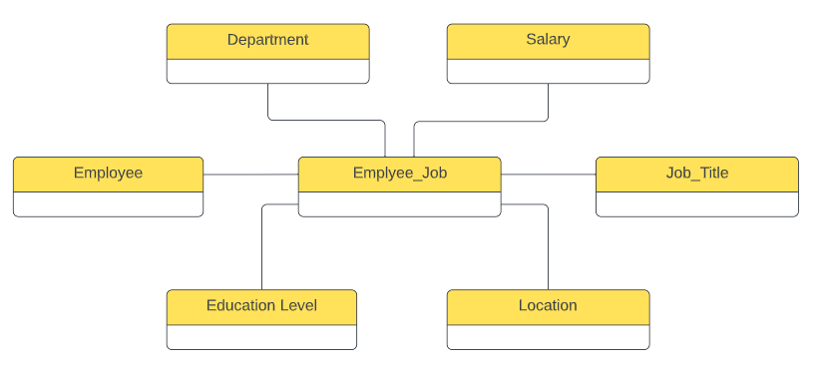
ERD
Conceptual

Slide 11
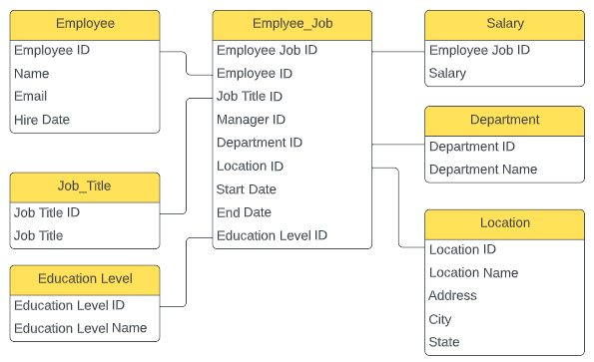
ERD
Logical

Slide 12
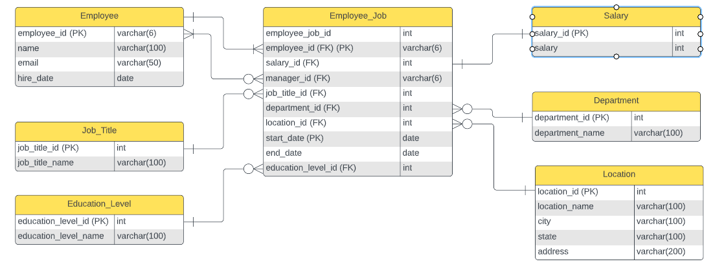
ERD
Physical

Slide 13
Step 3
Create A Physical Database

Slide 14
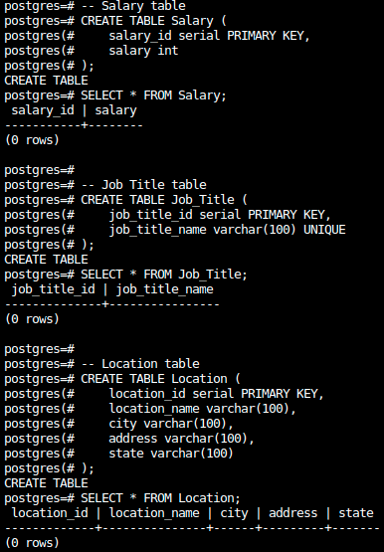
DDL

Slide 15
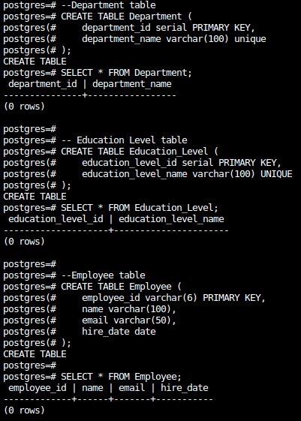
DDL

Slide 16
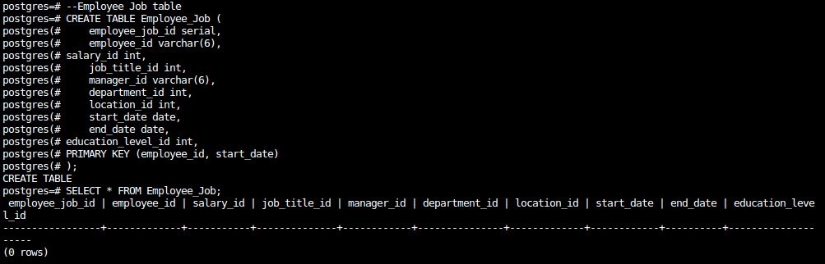
DDL

Slide 17
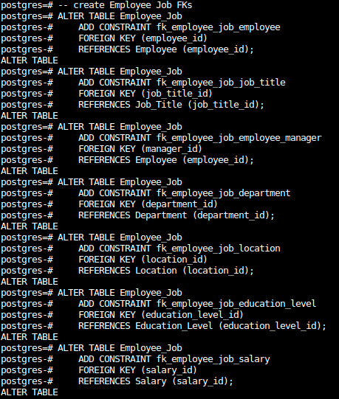
DDL

Slide 18
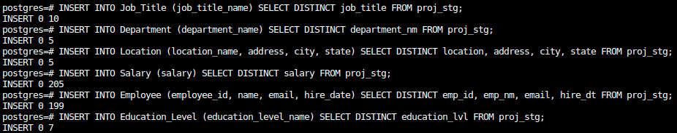
DDL

Slide 19
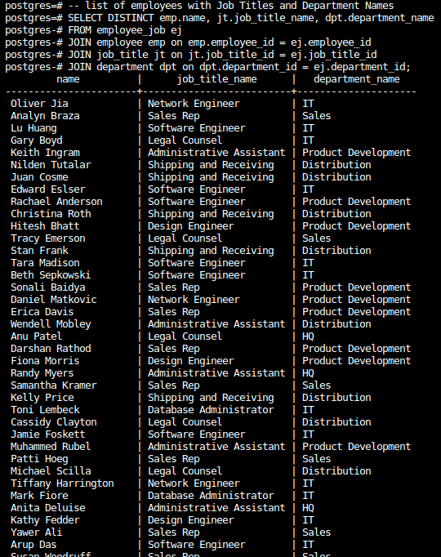
CRUD
Question 1: Return a list of employees with Job Titles and Department Names

Slide 20
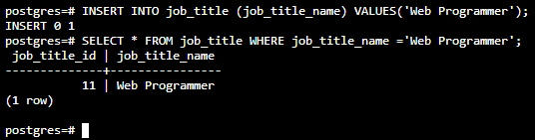
CRUD
Question 2: Insert Web Programmer as a new job title

Slide 21
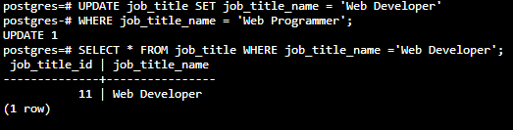
CRUD
Question 3: Correct the job title from web programmer to web developer

Slide 22

CRUD
Question 4: Delete the job title Web Developer from the database

Slide 23
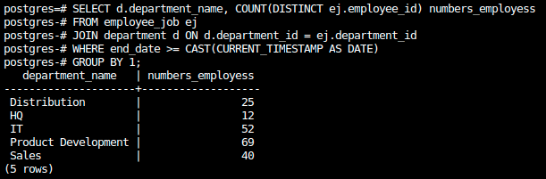
CRUD
Question 5: How many employees are in each department?

Slide 24
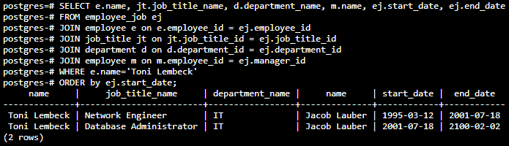
CRUD
Question 6: Write a query that returns current and past jobs (include employee name, job title, department, manager name, start and end date for position) for employee Toni Lembeck.

Slide 25
CRUD
Question 7: Describe how you would apply table security to restrict access to employee salaries using an SQL server.
As the database has a separated table for the salaries we can create two roles, one for the employee users and another for the ones that can read the salaries table.
For the employee that can’t read this salary table we can revoke the read access to it.

Slide 26
Step 4
Above and Beyond (optional)

Slide 27
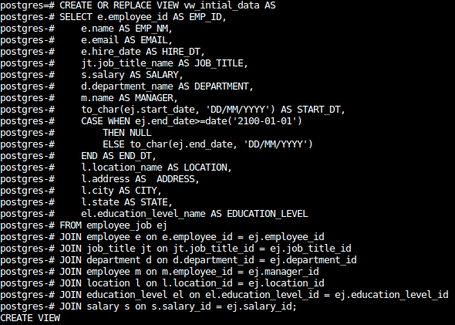
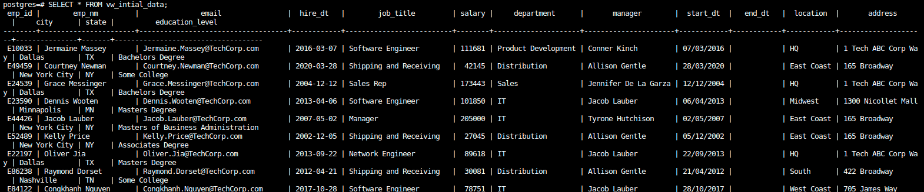
Standout Suggestion 1
Create a view that returns all employee attributes; results should resemble initial Excel file

Slide 28
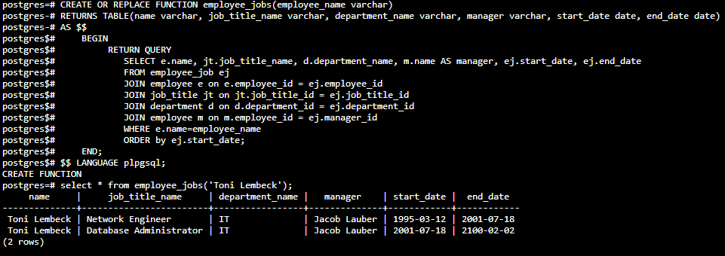
Standout Suggestion 2
Create a stored procedure with parameters that returns current and past jobs (include employee name, job title, department, manager name, start and end date for position) when given an employee name.

Slide 29
Standout Suggestion 3
Implement user security on the restricted salary attribute.
Create a non-management user named NoMgr. Show the code of how your would grant access to the database, but revoke access to the salary data.
Submit screenshot of code

